Slide 1
AI-Driven Stock Rebalancing for Demand-Responsive Retail
Move the Right Stock, to the Right Store, at the Right Time
Clustering-Based Demand Signals + Optimization-Driven Transfers
Smart Inventory Redistribution is an AI-powered decision engine designed to continuously rebalance inventory across stores, warehouses, and regions based on real-time demand signals.
Traditional inventory systems treat each store in isolation, leading to overstock in low-demand locations and stockouts in high-demand ones. This application breaks that silo by analyzing demand patterns, inventory health, logistics constraints, and transfer costs — then recommending optimal stock movements that maximize service levels while minimizing operational cost.
The system combines:
Demand forecasts from Stage 1
Inventory health metrics
Store and cluster-level demand behavior
Logistics and route feasibility
Optimization models for transfer decisions
The result is a data-driven redistribution strategy that adapts dynamically as demand changes.

Slide 2
❓ Why This Matters
🚨 The Retail Problem
Inventory is capital locked on shelves
Overstock leads to markdowns and wastage
Stockouts lead to lost revenue and poor customer experience
Manual transfers are slow, reactive, and cost-inefficient
🚀 The AI Advantage
This stage transforms inventory management from reactive replenishment to proactive rebalancing by:
✔ Identifying excess stock before it becomes dead inventory
✔ Detecting emerging demand hotspots early
✔ Optimizing inter-store transfers using AI models
✔ Reducing unnecessary procurement and logistics costs
✔ Improving fill rates and customer satisfaction

Slide 3

Data Collection & Integration (Unified Data Ingestion)
This section consolidates data from multiple enterprise sources into a single analytical model.
Integrated Data Domains:
Customer behavior & loyalty
Product master & pricing
Store & sales channel data
Promotions & events
Inventory & stock conditions
Weather & market trends
Time & seasonality signals
All data is validated and aligned using a consistent dimensional model to ensure forecasting accuracy.

Slide 4
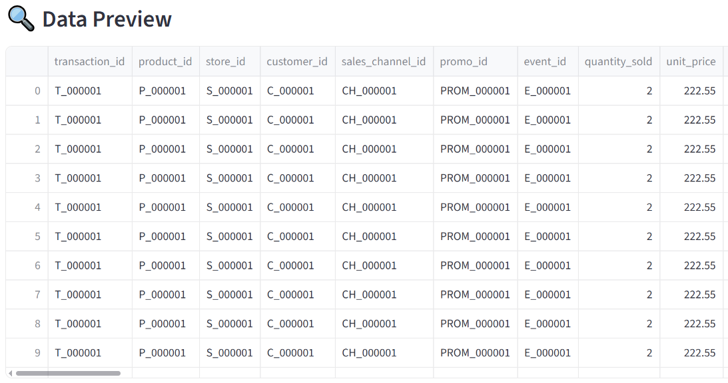

Slide 5

Data Pre-Processing (Data Quality & Readiness)
This section ensures the dataset is model-ready by handling:
Missing values & inconsistencies
Outliers & anomalies
Data type validation
Referential integrity checks across dimensions
Time alignment and granularity normalization
This step guarantees that downstream models are trained on clean, reliable, and trustworthy data.
🔍 What this does
This step identifies and removes exact duplicate records from the dataset.

Slide 6
Duplicate rows often occur due to:
Multiple data ingestion runs
System retries or sync issues
Manual data merges
🎯 Why this is important
Prevents double counting of sales, customers, or inventory
Ensures accurate aggregates and trends
Avoids biased model training caused by repeated observations
🧠 How it helps forecasting
Demand models rely on true historical patterns.
Duplicates distort demand signals and inflate sales volumes, leading to over-forecasting.

Slide 7

🔍 What this does
For non-critical categorical fields, missing values are replaced with a placeholder like:
“Unknown”
Examples:
Customer Gender
Promotion Type
Event Category
Payment Type
🎯 Why this is important
Preserves valuable records instead of discarding them
Keeps categorical columns consistent
Allows models to learn from “unknown” patterns rather than losing data

Slide 8

🧠 Modelling advantage
Many ML models can handle a distinct “Unknown” category better than missing values.
This improves:
Model stability
Feature completeness
Interpretability
🔍 What this does
This step converts safe, measurable columns into numeric formats so they can be used in analysis and ML models.

Slide 9
📌 Examples of safe numeric columns
Quantity Sold
Unit Price
Total Sales Amount
Discount Applied
Tax Amount
Satisfaction Score
Forecast Quantity
🚫 What is NOT converted
IDs (Product ID, Store ID, Customer ID)
Categorical labels
Descriptive text fields
🎯 Why this is important
Enables mathematical operations and aggregations
Required for correlation analysis and model training
Prevents runtime errors in ML pipelines

Slide 10
🧠 Why “safe columns only” matters
Blindly converting columns can:
Corrupt IDs
Break joins
Create misleading numerical patterns
This step ensures only logically numeric fields are converted.
Exploratory Data Analysis (EDA)
Provides high-level insights to understand data behavior before model engineering.
Key Insights Generated:
Sales and demand patterns over time
Customer purchase behavior and loyalty trends
Product category and brand performance

Slide 11

Store and regional sales distribution
Promotion and event effectiveness
Weather and trend influence on demand
This section focuses on interpretability, not deep statistical modeling.
1️⃣ Data Quality Overview
Expanding this section should display the below summary and the function result
🔍 What this section does
This section provides a high-level health check of the dataset before any modeling or forecasting is attempted.
It evaluates:
Missing values
Duplicate records
Data type consistency
Overall row and column completeness

Slide 12
🎯 Why this matters
Demand forecasting models are highly sensitive to poor data quality.
Even small inconsistencies (missing prices, invalid quantities, duplicate transactions) can significantly distort predictions.
🧠 Key insights users get
Whether the dataset is model-ready
Which columns require cleaning or transformation
Confidence in the reliability of downstream analysis

Slide 13

2️⃣ Sales Overview
Expanding this section should display the below summary and the function result
🔍 What this section does
This provides a macro-level snapshot of sales performance, answering the question:
“What does overall sales look like across time?”
It typically highlights:
Total revenue
Total units sold
Average order value
Sales trends over time

Slide 14
🎯 Why this matters
Before diving into granular analysis, it’s important to understand:
Overall business scale
Growth or decline patterns
Presence of seasonality or anomalies
🧠 Key insights users get
Baseline sales behavior
Early signals of trends or volatility
Context for all deeper analyses

Slide 15
I need a list of Analtyics in the EDA Section as shown example from slide #11 to #14 (Add wrt to all the dimensions and fact that you have)
Data Quality Analysis
Product Analysis
Customer Analysis
Store Analysis
Vendor Analysis
Location Analysis
Warehouse Analysis
Transport Route Analysis
Sales Analysis
Inventory Analysis
Redistribution Analysis
Reallocation Analysis
Logistics Analysis

